Slide 1


Fake Job Postings
Detection System
Detecting Fraudulent Job Listings with Machine Learning

Slide 2










Agenda
Introduction
Impact & Problem Significance
Dataset Description
Data Cleaning & Preprocessing
Exploratory Data Analysis (EDA)
Machine Learning Model & Evaluation
Conclusion, Recommendations & Future Work
Samsung Innovation Campus

Slide 3




Team Members
Hamdy Osama
Mohamed Kassab
Saja Elsayed
Yousef Mohamed
Samsung Innovation Campus

Slide 4
Introduction
Samsung Innovation Campus

Slide 5
Project Overview & Problem Statement
The Business Problem
Job platforms are flooded with fake listings designed to steal money or personal data from applicants. This erodes user trust in hiring platforms and wastes job seekers' time and effort.
Our Mission & Goal
Build an automated machine learning classifier that reads a job posting's text and metadata to predict whether it is Real (0) or Fraudulent (1) — enabling platforms to flag scams before they reach job seekers.
Problem Framing: Supervised Binary Classification with Highly Imbalanced Target
Samsung Innovation Campus

Slide 6
Why This Matters (Business Impact)
$501M
4.8%
Personal Data Risk
Reported U.S. job-scam losses in 2024 (up from $90M in 2020)
Source: FTC Data Book 2024
Fraudulent rate in dataset (866 / 17,880 listings)
Rare event, but high financial impact
Scams harvest IDs, bank info, or demand upfront "fees" from vulnerable applicants.
Samsung Innovation Campus

Slide 7
Dataset Overview & Schema
Source & Dimensions
17,880 Job Postings
18 Original Attributes (Text, Categorical, Binary)
Target Imbalance Split
Real: 17,014 (95.2%) | Fraudulent: 866 (4.8%)
Key Original Features
Text Fields: title, location, department, company_profile, description, requirements, benefits
Categorical Fields: employment_type, required_experience, required_education, industry, function
Binary Flags: telecommuting, has_company_logo, has_questions
Samsung Innovation Campus

Slide 8
Data Cleaning & Preprocessing
Samsung Innovation Campus

Slide 9



Data Cleaning Architecture
Missing Values
All missing categorical/text values filled with . 0 rows dropped (100% retention).
Duplicates Audit
Audited dataset for fully identical row duplicates. 0 duplicates detected across dataset.
6-Step Text Cleaning
Lowercase | Strip HTML | Remove URLs | Remove Emails | Remove Punctuation | Collapse Whitespace
Samsung Innovation Campus

Slide 10
Feature Engineering
Samsung Innovation Campus

Slide 11
Feature Engineering Strategy
New Feature | What It Captures
missing_fields_count | Total number of missing fields per posting — a proxy for listing "incompleteness".
has_salary, has_description, ... | Binary flags (1 or 0): presence of specific information (company profile, requirements, benefits, location).
job_context | Combined text of title + industry + function to provide domain context.
title_len, description_len | Character lengths of title and description fields.
These features don't directly label a posting as fraudulent but they provide the model with vital structural context and metadata completeness signals that raw text alone misses.
Samsung Innovation Campus

Slide 12
Exploratory Data Analysis (EDA)
Samsung Innovation Campus

Slide 13
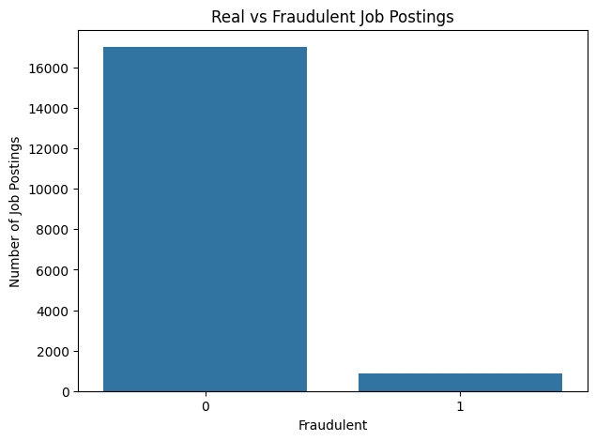
EDA
Visualize the class distribution
0 = Real (about 17,800 real job postings)
1 = Fraudulent (about 800 fraudulent postings)
Samsung Innovation Campus

Slide 14
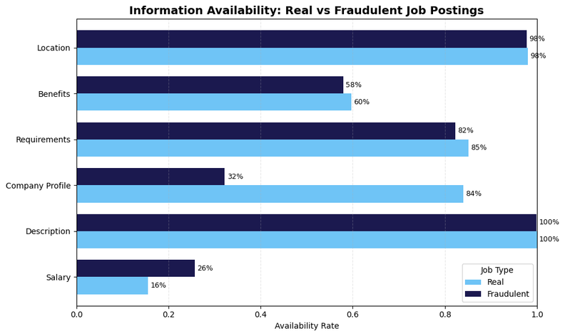
EDA
Compare information availability between real and fraudulent job postings
Samsung Innovation Campus

Slide 15
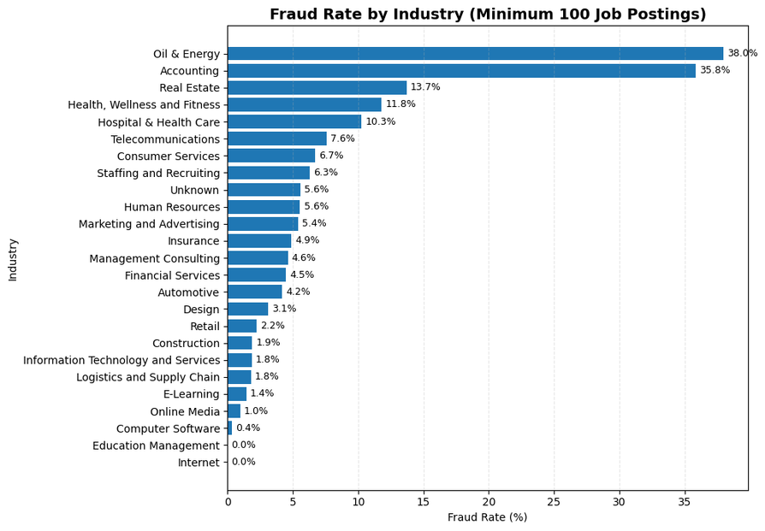
EDA
Analyze fraud rates by industry while excluding small categories
Samsung Innovation Campus

Slide 16
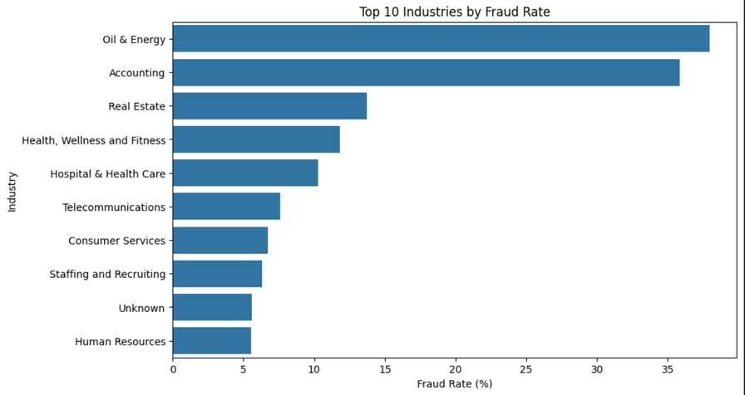
EDA
Visualize the top 10 industries by fraud rate
Samsung Innovation Campus

Slide 17
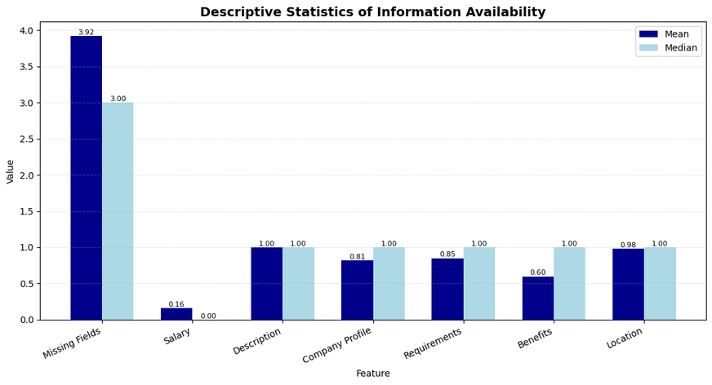
EDA
Descriptive statistics for information availability features
Samsung Innovation Campus

Slide 18
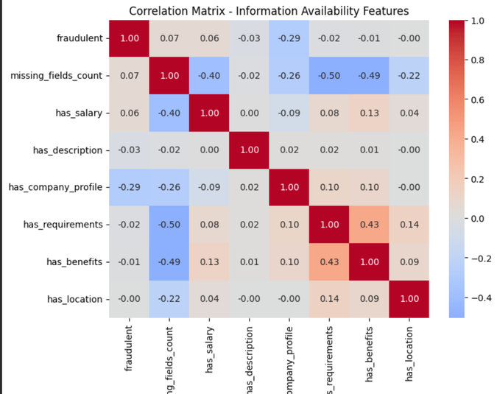
EDA
Correlation Analysis
Samsung Innovation Campus

Slide 19
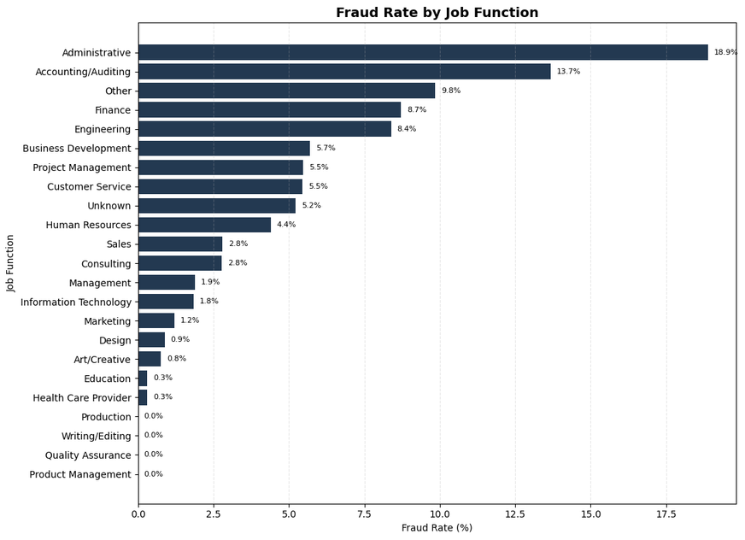
EDA
Analyze fraud rates by job function while excluding small categories
Samsung Innovation Campus

Slide 20
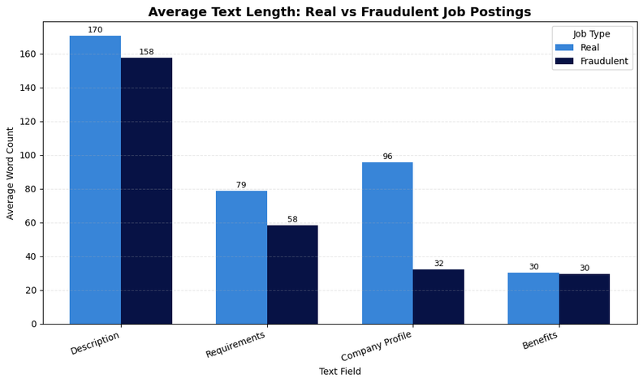
EDA
Fraudulent postings tend to have shorter text, especially in company profiles. Benefits show almost no difference between real and fraudulent postings.
Samsung Innovation Campus

Slide 21
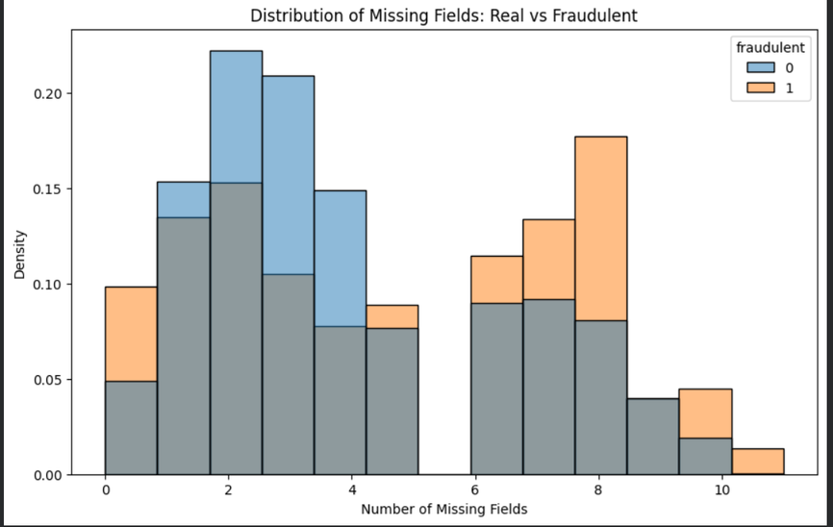
EDA
Distribution of missing fields for real vs fraudulent job postings
Samsung Innovation Campus

Slide 22
Machine Learning Model & Evaluation
Samsung Innovation Campus

Slide 23
Our Experimental Approach
Try → Evaluate → Compare → Improve
We followed an experimental approach:
  Prepare the data and create meaningful features.
  Apply the same preprocessing pipeline to ensure a fair comparison.
  Try different ML models and hyperparameters.
  Evaluate their performance using multiple metrics.
  Compare the results and identify the strongest approach
Main goal:
Find the model that best detects fraudulent job postings.
Evaluation:
Precision | Recall | F1-score | ROC-AUC
Samsung Innovation Campus

Slide 24
EX1 — One-Hot Encoding + Numerical Features
What if we detect fraud without using text features?
1)Feature Engineering
Used categorical + numerical features only.
No text features were used.
Categorical Features
  employment_type
  required_experience
  required_education
  industry
  function
Numerical Features
  Text length + information availability features
Samsung Innovation Campus

Slide 25
EX1 — One-Hot Encoding + Numerical Features
Used categorical + numerical features only.
No text features were used.
2)Preprocessing
  One-Hot Encoding for categorical features.
  StandardScaler for numerical features.
  Used the same train/test split.
  Tested 6 ML models.
  No hyperparameter tuning was applied.
Samsung Innovation Campus

Slide 26
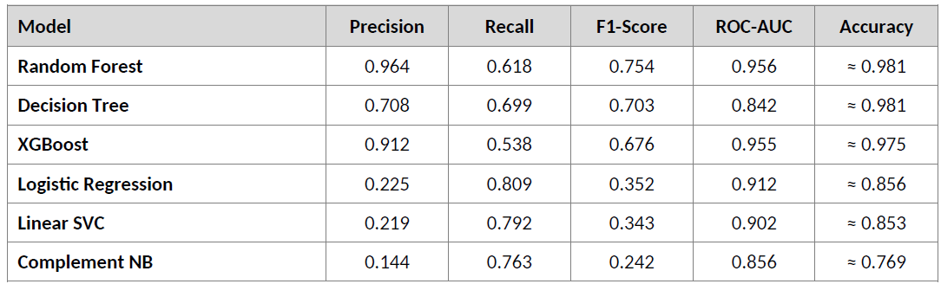
EX1 — One-Hot Encoding + Numerical Features
Best Models: Best F1 — Random Forest (0.754). Best Recall — Logistic Regression (0.809). Best Precision — Random Forest (0.964). Best ROC-AUC — Random Forest (0.956).
Conclusion: Random Forest gave the strongest overall performance, with F1 = 0.754 and Precision = 0.964. Logistic Regression achieved the highest Recall (0.809), but its low Precision reduced its F1-score.
Samsung Innovation Campus

Slide 27
EX2 — Ordinal Encoding + Numerical Features
What if we keep the same features but change the categorical encoding method?
1)Feature Engineering
  Used the same categorical + numerical features as EX1.
  No text features were used.
  The only change was the categorical encoding method.
Samsung Innovation Campus

Slide 28
EX2 — Ordinal Encoding + Numerical Features
What if we keep the same features but change the categorical encoding method?
2)Preprocessing
  Ordinal Encoding for categorical features.
  StandardScaler for numerical features.
  Used the same train/test split.
  Tested the same 6 ML models.
  No hyperparameter tuning was applied
Samsung Innovation Campus

Slide 29
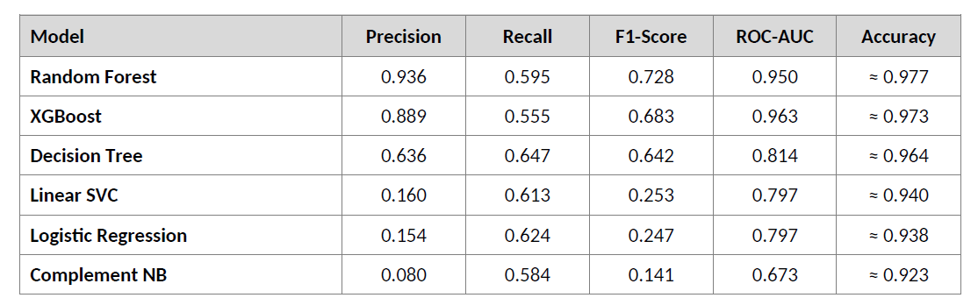
EX2 — Ordinal Encoding + Numerical Features
  Best Models: Best F1 — Random Forest (0.728). Best Recall — Decision Tree (0.647). Best Precision — Random Forest (0.936). Best ROC-AUC — XGBoost (0.963).
  Conclusion: Random Forest remained best, but F1 dropped from 0.754 (One-Hot) to 0.728 (Ordinal); linear models degraded considerably. One-Hot Encoding is preferred; Ordinal is kept only as a comparison.
Samsung Innovation Campus

Slide 30
EX3 — Classical Machine Learning
From Raw Data to Model
1)Feature Engineering
Text Features
  job_context :- title + industry + function
Categorical Features
  employment_type
  required_experience
  required_education
  industry
  function
Numerical Features
  Text length + information availability features
Samsung Innovation Campus

Slide 31
EX3 — Classical Machine Learning
From Raw Data to Model
2)Preprocessing
  TF-IDF for text features.
  One-Hot Encoding for categorical features.
  StandardScaler for numerical features.
  Applied MINMAX to numerical features at Complement Naive Bayes
  Used class weights to handle class imbalance.
  Applied GridSearchCV to tune the model
Samsung Innovation Campus

Slide 32
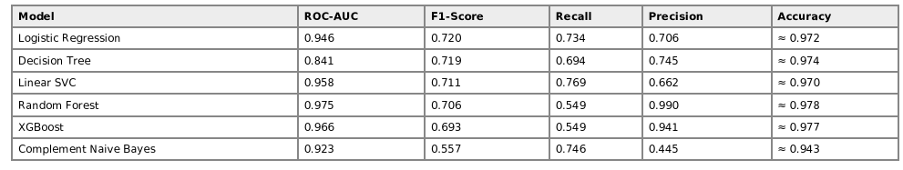
EX3 — Classical Machine Learning
From Raw Data to Model
  EX1 Best Models: Best F1 — Logistic Regression (0.720). Best Recall — Linear SVC (0.769). Best Precision — Random Forest (0.990). Best ROC-AUC — Random Forest (0.975)
  Conclusion: Logistic Regression achieved the highest F1-score (0.720), providing the best overall F1 performance in EX1.
Samsung Innovation Campus

Slide 33
EX4 — Text + Numerical Features
What if we rely more on the actual content of the job posting and remove the categorical information?
1)Feature Engineering
Kept numerical features such as text length and information availability.
Removed categorical One-Hot features
Text Features
  text_combined {title+description+requirements+benefits}
Numerical Features
  Text length + information availability features
Samsung Innovation Campus

Slide 34
EX4 — Text + Numerical Features
What if we rely more on the actual content of the job posting and remove the categorical information?
2)Preprocessing
  Applied TF-IDF to the combined text.
  Used 1–2 grams to capture words and short phrases.
  Applied StandardScaler to numerical features.
  Applied MINMAX to numerical features at Complement Naive Bayes
  Used the same train/test split for fair comparison.
  Trained multiple ML models.
Samsung Innovation Campus

Slide 35
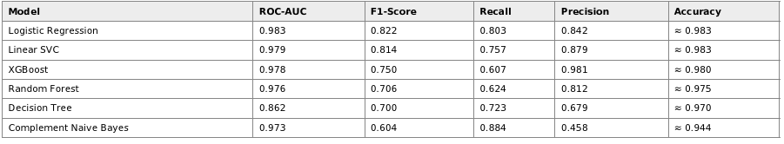
EX4 — Text + Numerical Features
What if we rely more on the actual content of the job posting and remove the categorical information?
  EX2 Best Models: Best F1 — Logistic Regression (0.822). Best Recall — Complement Naive Bayes (0.884). Best Precision — XGBoost (0.981). Best ROC-AUC — Logistic Regression (0.983).
  Conclusion: Logistic Regression achieved the highest F1-score (0.822) Overall, Logistic Regression provided the best balance between precision and recall in EX2.
Samsung Innovation Campus

Slide 36
EX5 — Handling Class Imbalance
But what if the remaining challenge is the class imbalance and make Numerical feature Selection?
Our Approach
Try different oversampling techniques → Evaluate their impact → Compare the results
1)Feature Engineering
  Reused the Text + Numerical feature Selection
  Combined the main job-posting text fields.
  Used TF-IDF for text representation.
  Kept the same numerical and information-availability features.
Samsung Innovation Campus

Slide 37
EX5 — Handling Class Imbalance
But what if the remaining challenge is the class imbalance and make Numerical feature Selection?
2)Preprocessing
  Applied TF-IDF to text.
  Applied StandardScaler to numerical features.
  Tested two imbalance techniques:
  Random OverSampling (ROS)
  SMOTE
  Resampling was applied only to the training data.
  Tested multiple ML models.
Samsung Innovation Campus

Slide 38
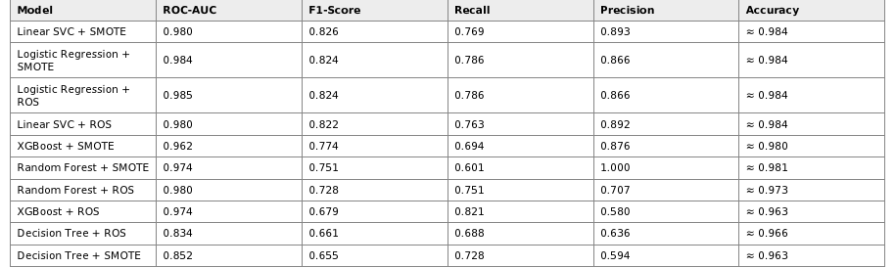
EX5— Handling Class Imbalance
But what if the remaining challenge is the class imbalance and make Numerical feature Selection?
  EX3 Best Models: Best F1 — Linear SVC + SMOTE (0.826). Best Recall — XGBoost + ROS (0.821). Best Precision — Random Forest + SMOTE (1.000). Best ROC-AUC — Logistic Regression + ROS (0.985).
  Note: Random Forest + SMOTE reached perfect precision (1.000) but the second-lowest recall in the table (0.601), a sign of the model becoming overly conservative on synthetic minority samples rather than a genuinely better model.
Samsung Innovation Campus

Slide 39
EX6 — Ensemble Learning
What if instead of choosing one model, we combine the best ones?
Different models may make different mistakes,combining them can improve the final decision.
Hard Voting → Majority vote between the models.
Stacking→ Uses a Logistic Regression model to learn how to combine the base models' predictions.
We tested two approaches:
How Did We Build the Ensembles?
1)Feature Engineering
We Used the best model variants from EX3.
  Selected four strong base models:
  Logistic Regression + ROS
  Linear SVC + ROS
  Random Forest + SMOTE
  XGBoost + SMOTE
  Their predictions were used as inputs for ensemble methods
Samsung Innovation Campus

Slide 40
EX6— Ensemble Learning
What if instead of choosing one model, we combine the best ones?
2)Preprocessing
  Built two ensemble approaches:
  Hard Voting
  Stacking
  Hard Voting → majority decision.
  Stacking → Logistic Regression learns how to combine model predictions.
Samsung Innovation Campus

Slide 41
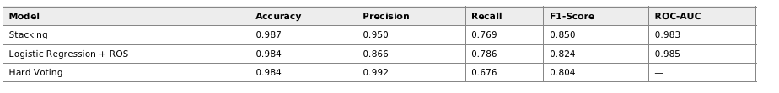
EX6— Ensemble Learning
What if instead of choosing one model, we combine the best ones?
Conclusion: The Stacking ensemble achieved the highest F1-score (0.850), providing the best overall performance among the evaluated ensemble approaches. Hard Voting achieved the highest precision (0.992), but its recall was lower (0.676), resulting in a lower F1-score. Overall
Samsung Innovation Campus

Slide 42
EX7 — DistilBERT Feature Extraction (Frozen)
What if instead of representing the job text using TF-IDF,
we use a Transformer that understands context?
We tested two approaches:
Point A ) Frozen DistilBERT
  Used pre-trained DistilBERT as a frozen feature extractor.
  DistilBERT weights were not updated during training.
  Extracted contextual text embeddings using mean pooling.
  Combined the embeddings with numerical features.
  Trained classical ML models on the combined features.
Samsung Innovation Campus

Slide 43
EX7— DistilBERT Feature Extraction vs Fine-Tuning
What if instead of representing the job text using TF-IDF,
we use a Transformer that understands context and train data?
Point B )Fine-Tuned DistilBERT
  Used pre-trained DistilBERT and fine-tuned it on the job fraud dataset.
  Unlike Point A, the DistilBERT weights were updated during training.
  Combined the learned text representation with numerical features.
  Added a classification layer to predict Legitimate vs Fraudulent jobs.
  F1-score: 0.865
  ROC-AUC: 0.989
  PR-AUC: 0.912
  Conclusion
  Fine-Tuned DistilBERT performed better than the frozen version.
  It achieved the highest F1-score: 0.865.
  It also outperformed our previous best model, Stacking: 0.850.
  Fine-Tuned DistilBERT was our best model.
Samsung Innovation Campus

Slide 44
Conclusion, Recommendations & Future Work
Samsung Innovation Campus

Slide 45
Conclusion, Recommendations & Future Work
Conclusion
  We tested different ML, ensemble, and Transformer approaches.
  Each experiment helped us improve our fraud detection.
  Stacking achieved a strong F1-score of 0.850, However, it is slower and more time-consuming because it combines multiple models.
  Fine-Tuned DistilBERT achieved the highest F1-score of 0.865.
  Linear SVC provides the best overall trade-off between performance and computational time.
  Therefore, Linear SVC is the preferred model for practical use.
Recommendations
  Use Linear SVC when speed and efficiency are more important.
  Keep text + numerical features for better fraud detection.
  Focus on F1-score because the dataset is imbalanced.
Future Work
.
  Try other Transformer models such as BERT or RoBERTa.
Samsung Innovation Campus

Slide 46

ⓒ2020 SAMSUNG. All rights reserved.
Samsung Electronics Corporate Citizenship Office holds the copyright of book.
This book is a literary property protected by copyright law so reprint and reproduction without permission are prohibited.
To use this book other than the curriculum of Samsung innovation Campus or to use the entire or part of this book, you must receive written consent from copyright holder.

